Slide 1
Electronic Instrumentation Section-1, Ppt-8

Slide 2
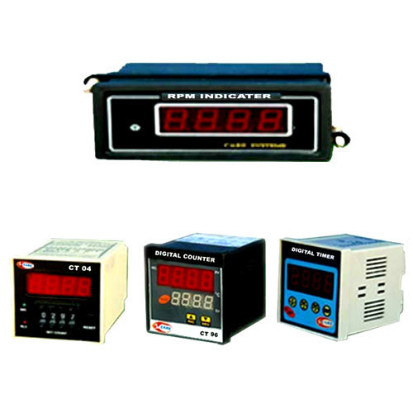
Universal Timer/Counter

Slide 3
The conventional counter is a digital electronic device which measures the frequency of an input signal.
Period of the input signal
Ratio of the frequency of two input signals,
Time interval between two events

Slide 4
Functions of the Conventional Counter
Frequency Measurement
f = n / t.
where n is the number of cycles of the repetitive signal that occurs in time interval, t.
If t = 1 second, then the frequency is expressed as n cycles per second or n Hertz.

Slide 5
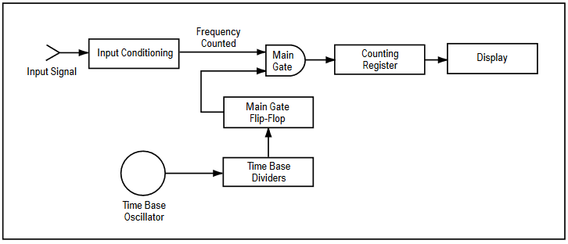

Slide 6
The frequency counted is displayed on a visual numerical readout.
For example, if the number of pulses totaled by the counting register is 50,000, and the selected gate time is one second, the frequency of the input signal is 50,000 Hertz.

Slide 7

Period Measurement
The period, P, of an input signal is the inverse of its frequency.
The period of a signal is therefore the time taken for the signal to complete one cycle of oscillation.
If the time is measured over several input cycles, then the average period of the repetitive
signal is determined. This is often referred to as multiple period averaging

Slide 8
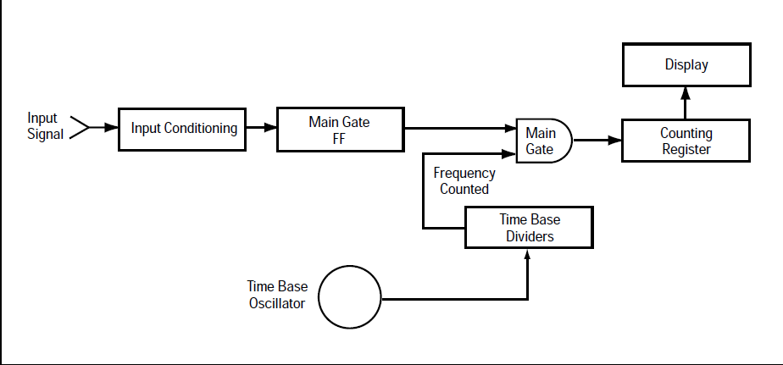

Slide 9
Period measurement allows more accurate measurement of unknown low-frequency signals because of increased resolution.
For example, a frequency measurement of 100 Hz on a counter with 8-digit display and a 1-second gate time will be displayed as 00000.100 KHz.
A single period measurement of 100 Hz on the same counter with 10 MHz time base would display 0010000.0 ms.

Slide 10
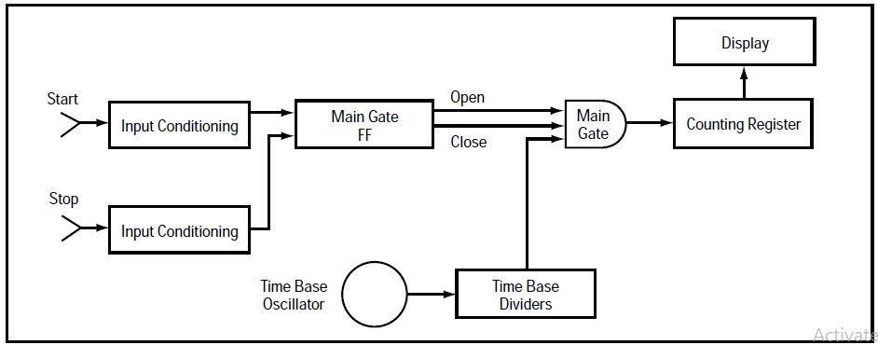
Time Interval Measurement

Slide 11
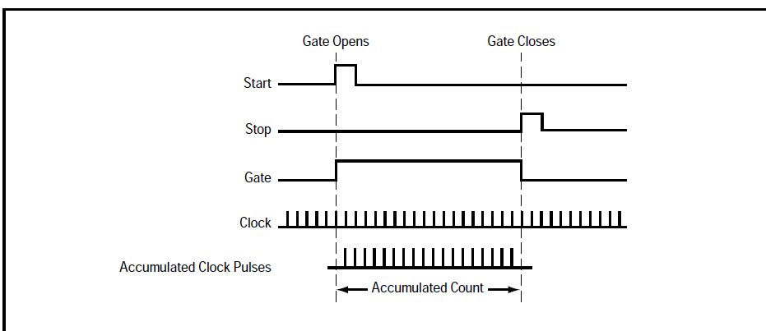

Slide 12
Benefits or advantages of Electronic Counter
Following are the benefits or advantages of Electronic Counter: ➨They are available in several mounting configurations. ➨There is large demand of electronic counters for applications such as setting up AC timer, setting timer to take pictures in camera, as clock divider etc. ➨They are available in low cost to medium cost depending upon the configurations and specifications. ➨They are widely used for manufacturing purposes, for controlling batch sizes, punch/drill products etc. ➨It can be used for long duration with minimum maintenance. ➨It offers digital readouts. ➨It can be easily installed and it is available in semi-automatic to automatic modes.

Slide 13
Drawbacks or disadvantages of Electronic Counter
Following are the drawbacks or disadvantages of Electronic Counter: ➨There are chances of operational error which depends on configurations of electronic counter machine. ➨It requires training to operate it efficiently and hence increases cost on training or in hiring skilled professionals. ➨It is medium to heavy in weight.

Slide 14
In digital logic, a counter is a device which ____________ a) Counts the number of outputs b) Stores the number of times a particular event or process has occurred c) Stores the number of times a clock pulse rises and falls d) Counts the number of inputs

Slide 15
A counter circuit is usually constructed of ____________ a) A number of latches connected in cascade form b) A number of NAND gates connected in cascade form c) A number of flip-flops connected in cascade d) A number of NOR gates connected in cascade form

Slide 16
Thank you

